Slide 1
Module 2: Mandated Tasks of United Nations Peacekeeping Operations
Lesson
2.4
Women, Peace and Security

Slide 2
Relevance
Peacekeeping personnel:
Protect and promote women’s human rights
Protect women and girls from sexual violence
Role model for gender equality
UN Core Pre-Deployment Training Materials 2017

Slide 3
Learning Outcomes
Learners will:
Explain different impact of conflict on women and girls, men and boys
Explain how women are victims of conflict and key partners for peace
Explain “gender equality”, “gender mainstreaming” and importance
List actions to take to protect women and support gender equality
UN Core Pre-Deployment Training Materials 2017

Slide 4
Lesson Overview
Definitions
Importance of Attention to Women, Peace & Security (WPS)
Legal Framework
UN Partners Leading in WPS
DPKO-DFS Policy on Gender Equality
Gender Equality in UN Peacekeeping
Roles & Responsibilities
What Individual Peacekeeping Personnel Can Do
UN Core Pre-Deployment Training Materials 2017

Slide 5
Learning Activity
2.4.1
Differences between Women and Men – Sex or Gender?
Instructions:
Define “sex” and “gender”
Give examples of gender stereotypes
Discuss how gender results in inequalities
Should treatment be the same or different?
Time: 5 minutes
Group work: 3 minutes
Discussion: 2 minutes
UN Core Pre-Deployment Training Materials 2017

Slide 6
1. Definitions
The sex of a person is: | The gender of a person:
Biologically defined Usually determined by birth Universal | Is socially constructed Differs and varies across cultures and time Results in different roles, responsibilities, opportunities, needs and constraints for women, men, girls and boys
UN Core Pre-Deployment Training Materials 2017

Slide 7
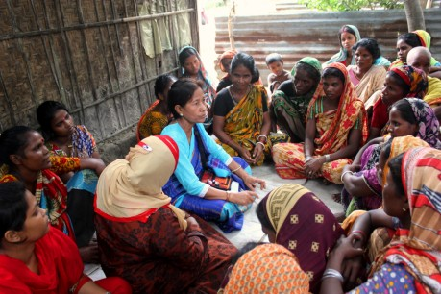
1. Definitions
Gender equality: | For women, girls, men, boys Equal rights, responsibilities, opportunities Consideration of interests, needs, priorities
UN Core Pre-Deployment Training Materials 2017

Slide 8
1. Definitions
Gender perspective: | Looks at the impact of gender on people’s opportunities, social roles, interactions
Gender mainstreaming: | Process of assessing implications of planned action for women and men Ultimate goal is gender equality
Gender balance: | Equal representation of women and men at all levels of employment Ultimate goal is gender equality
Empowerment of women: | Women gaining power and control in their lives
UN Core Pre-Deployment Training Materials 2017

Slide 9
Learning Activity
2.4.2
Impact of Conflict on Women and Girls
Instructions:
Consider the testimonies of civilians
List examples of how women and girls, men and boys experience conflict differently
Discuss the role of gender stereotypes
Time: 5 minutes
Group work: 3 minutes
Discussion: 2 minutes
UN Core Pre-Deployment Training Materials 2017

Slide 10
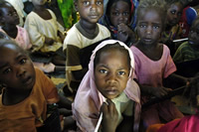
2. Importance of Attention to
Women, Peace and Security
Impact of Conflict on Women & Girls
Experienced differently
More vulnerable, heightened risk of violence due to social inequalities
Sexual violence and exploitation – rape, sexual slavery, enforced prostitution, trafficking
UN Core Pre-Deployment Training Materials 2017

Slide 11
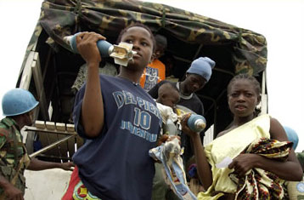
Key Partners in Peace
Women and girls not just victims in conflict
Actors in conflict and peace
Critical role in peace and security – sources of authority, information, change
UN Core Pre-Deployment Training Materials 2017

Slide 12
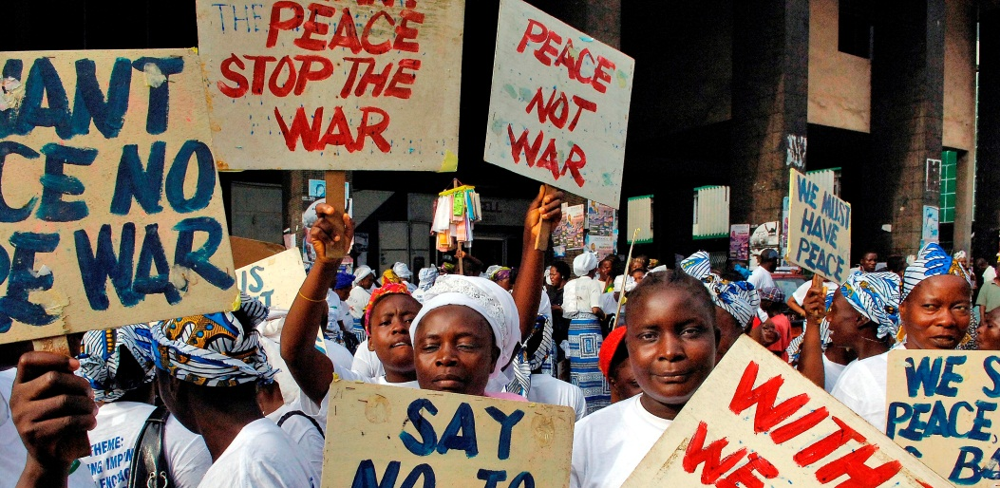
Achieving Gender Equality
Important goal in itself – an issue of human rights and social justice
UN Core Pre-Deployment Training Materials 2017

Slide 13
Learning Activity
2.4.3
Film: Women in Peacekeeping
Instructions:
How are women key partners of peace?
Using the film, explain “inclusiveness”, “non-discrimination” and “gender balance”
Time: 15 minutes
Film: 8:03 minutes
Discussion: 5-7 minutes
https://youtu.be/vAuFQj9xBYc
UN Core Pre-Deployment Training Materials 2017

Slide 14
3. Legal Framework
International Law
Convention on the Elimination of all Forms of Discrimination Against Women (CEDAW, 1979)
Agreed Conclusions of ECOSOC Coordination Segment on Gender Mainstreaming (1997)
Beijing Platform for Action (1995)
Windhoek Declaration and Namibia Plan of Action (2000)
UN Core Pre-Deployment Training Materials 2017

Slide 15
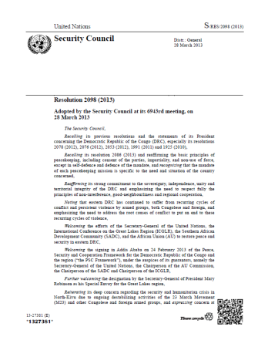
3. Legal Framework
Security Council resolutions on Women, Peace and Security (WPS) – 1325 (2000)
UN Core Pre-Deployment Training Materials 2017

Slide 16
4. UN Partners Leading in
Women, Peace and Security
UN Core Pre-Deployment Training Materials 2017

Slide 17
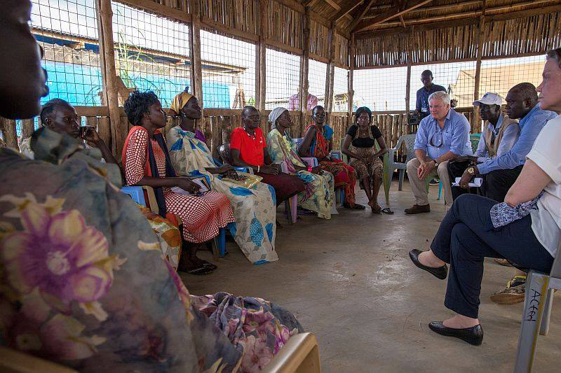
5. DPKO-DFS Policy on Gender Equality
Principles for gender equality:
Inclusiveness
Non-discrimination
Gender balance
Efficiency
Mainstream a gender
perspective in all plans,
policies, activities, analysis,
reports
UN Core Pre-Deployment Training Materials 2017

Slide 18
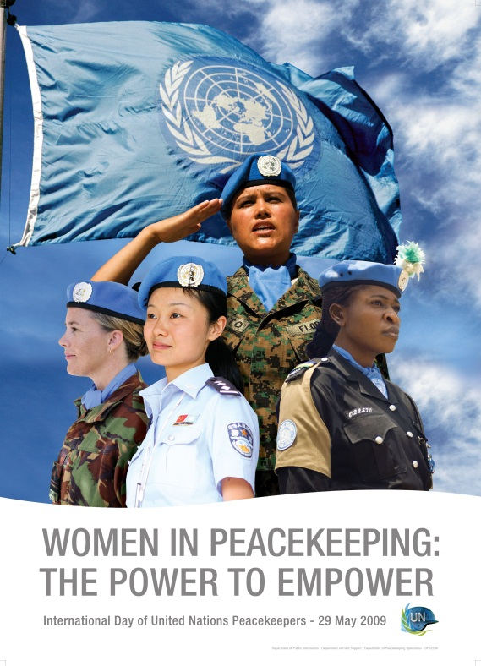
6. Gender Equality in UN Peacekeeping
Increase number of women
Address inequality in policy and practice
Advise on women-specific impacts of mission actions
Work with national partners to
address women’s and girls’
needs, rights
Work directly with women and
girls – voices heard, capacities
tapped into
UN Core Pre-Deployment Training Materials 2017

Slide 19
7. Roles & Responsibilities
Gender Adviser
Advise mission leadership and components
Mainstream gender perspectives
Capacity building of national and local partners
Coordination with UN partners
Develop and oversee the delivery of training on gender mainstreaming and SGBV
Coordination with Women Protection Advisers
Protection
Empowerment
Goal
UN Core Pre-Deployment Training Materials 2017

Slide 20
Related Roles
Gender Focal Points
Women Protection Advisers
Women Focal Points
UN Core Pre-Deployment Training Materials 2017

Slide 21
Gender Advisers vs. Women Protection Advisers
WPS Agenda
PILLAR 1 “Gender Equality” Gender Advisers | PILLAR 2 “Conflict Related Sexual Violence” Women Protection Advisers
UN Core Pre-Deployment Training Materials 2017

Slide 22
Other Units
Women Protection Adviser
Political Affairs
Civil Affairs
Human Rights
Child Protection
DDR
Humanitarian Affairs
Security Officers
Military
UNPOL
UN Core Pre-Deployment Training Materials 2017

Slide 23
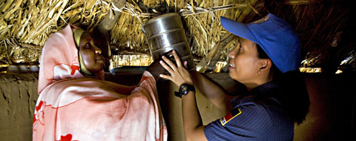
8. What Individual Peacekeeping Personnel Can Do
Promote equality
Observe carefully
Investigate properly
Report accurately
UN Core Pre-Deployment Training Materials 2017

Slide 24
Learning Activity
2.4.4
Gender Mainstreaming
Instructions:
Consider the scenarios
You must eliminate the discrimination and inequality experienced by women and girls
How would you integrate their concerns and experiences in the work carried out?
Time: 10 minutes
Brainstorming: 3 minutes
Discussion: 5-7 minutes
UN Core Pre-Deployment Training Materials 2017

Slide 25
Summary of Key Messages
Conflict has a different impact on women and girls, men and boys
Women and girls – not just victims, active in conflict and peace, key partners for peacekeeping and peacebuilding
“Gender equality” – equal rights, responsibilities, opportunities
Take action – be gender sensitive, promote equality, coordinate, intervene
UN Core Pre-Deployment Training Materials 2017

Slide 26
Questions
UN Core Pre-Deployment Training Materials 2017

Slide 27
Learning Activity
Learning Evaluation
UN Core Pre-Deployment Training Materials 2017

